Slide 1

Using answer set programming for knowledge representation and reasoning: future directions
Chitta Baral
Arizona State University

Slide 2
Apologies
For not being here physically on this special occasion

Slide 3
My early history with SMS
My Ph.D during 1987-1991
Finding the “right” semantics of negation in logic programming was an important topic
Liked the iterated fixed point definition of well-founded semantics, but did not like its “skeptical” nature at that time.
{ a ← not b; b ← not a; p ← a; p ←b }
Liked the simplicity of stable model semantics definition, liked its credulous nature, but did not like its treatment of { a ← ; p ← not p}
Developed various extension of well-founded semantics and the stable class semantics
Changed my focus after 1991 to Knowledge Representation using Stable Model Semantics
especially the domain of representing and reasoning about actions; and
the approach of provably correct representation.
Thankful to both Michael and Vladimir for that.

Slide 4
Knowledge Representation and SMS
Knowledge Representation and Reasoning is the cornerstone of AI
Dictionary meaning of “intelligence”
Even when learning; what does one learn?
From Michael’s Burlington award talk at University of Texas at El Paso:
Developing an appropriate language for KR is as fundamental to AI as Calculus is to Science and Engineering

Slide 5
Language for KR
The natural question: In what language do we represent knowledge and what is the basis of reasoning in that language?
It seems SMS is a good candidate for KR & R
However, not just SMS, but Knowledge Bases in general have not been as prevalent in AI systems as they should have been
Why?

Slide 6
Why Knowledge based reasoning is not as prevalent in AI systems
Developing a knowledge base is currently labor intensive
Mostly human crafted, and
without a lot of tools
The language and reasoning systems need some more development

Slide 7
Making knowledge base building easier
More knowledge engineering tools
Tools that help in modular development and verification of knowledge modules
Some progress has been made
Knowledge libraries
Some very basic attempts have been made
From Natural language text to knowledge modules
Initial steps

Slide 8
Further development of the SMS language and reasoning systems
Herbrand Universe or not?
Marc may touch upon this later
Vladimir, Joohyung are in the conference
Grounding or Not?
Several ongoing works
Combining probabilistic and logical reasoning
One of the reasoning it is needed
Matching learned knowledge with human crafted knowledge
Some work in the past
We are working on it: P-log

Slide 9
P-log (Baral, Gelfond and Rushton 2004; 2009)
Early version in LPNMR 2004; An extended version to appear in TPLP 2009
Some Key issues
Non-monotonicity in representing possible worlds
New information may force the reasoner to change (not just reduce) its collection of possible worlds.
Having the means to represent knowledge that is often noted “mentally” in many probabilistic formulations
Natural and common-sense blending of common-sense and probabilistic reasoning
Causality and probability

Slide 10
Possible worlds
T1
a : {1, 2, 3} % a can have possible values, 1 2 and 3
a = 1 ← not abnormal
random(a) ← abnormal
T1 has one possible world: { a= 1}
T2 = T1 U { abnormal}
T2 has three possible worlds:
{a = 1}, {a = 2}, {a = 3}

Slide 11
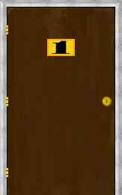
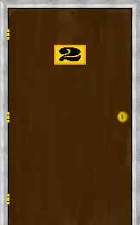
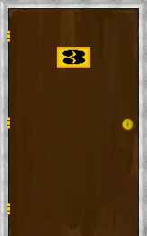
Monty Hall problem: 3 doors
One of the doors below has a prize. I am asked to pick a door.
(From http://math.ucsd.edu/~crypto/Monty/monty.html)

Slide 12
I pick door one.
(From http://math.ucsd.edu/~crypto/Monty/monty.html)

Slide 13
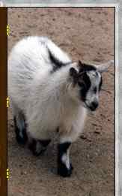
After I pick door 1 …
O4 -- Monty opens door 3 and shows me a goat.
Should I stay with door 1 or switch to door 2.
(From http://math.ucsd.edu/~crypto/Monty/monty.html )

Slide 14
The Monty Hall problem and non-trivial conditioning
Question: Does it matter if I switch?
Which unopened door has the higher probability of containing the prize?
The answer depends on:
Whether Monty knew where the prize is and on purpose opened a door which has a goat, Or
he randomly opened an unopened door which happened to have a goat.
If the first case then Switch.
[increases probability from 1/3 to 2/3]
If the second case it does not matter as probability remains 1/3.

Slide 15
Representing the Monty Hall problem in P-log.
doors = {1, 2, 3}.
open, selected, prize, D: doors
~can_open(D) ← selected = D.
~can_open(D) ← prize = D.
can_open(D) ← not ~can_open(D).
random(prize).
random(selected).
random(open: {X : can_open(X)}).
pr(prize = D) = 1/3. pr(selected = D) = 1/3.
obs(selected = 1). obs(open = 2). obs(prize ≠ 2).
P(prize = 1) =? P(prize=3)=?

Slide 16
P-log and KR
Many more P-log modeling of KR examples involving logic and probability is in the paper
Latest version is in my home page

Slide 17
Conclusion
I am honored.
My sincere apologies for not being here.
SMS is a good candidate for becoming the core of the calculus of AI
We need to continue to work together
On theory, implementation and building of knowledge engineering infrastructure

Slide 18
Questions on P-log
I guess I can ask Michael to answer those!
Thanks in advance Michael!

